Slide 1
“Changes call for innovation, and innovation leads to progress.”
- Li Keqiang

Slide 2

ANALYSYS OF SOCIAL MEDIA FEEDBACK TO GAIN
PROFIT FOR BUSINESS ORGANIZATIONS
Project Proposal Presentation

Slide 3
Group Details
Project Number: 18-025
Supervisor: Mr. Yashas Mallawarachchi
Members:
IT15087584 | S. A. R. V. Silva
IT15035004 | K. D. Y. Viduranga
IT15000354 | H. N. Mirando
IT15003942 | K. V. N. Withanage

Slide 4
INTRODUCTION

Slide 5
















Social Media

Slide 6
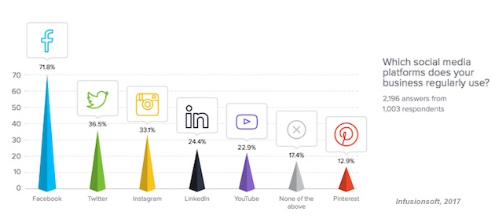
http://stgtricks.net/best-social-media-platforms-for-business-2018/

Slide 7
As a customer centric marketer, you need to understand your customers’ buying wants and needs

Slide 8
RESEARCH PROBLEM

Slide 9
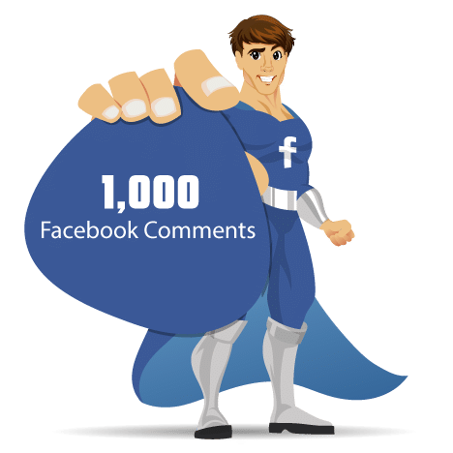





Slide 10

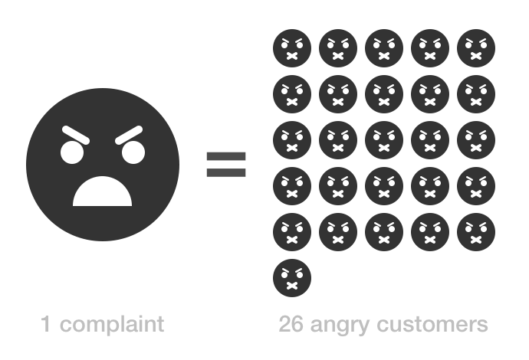


Time Consuming
Poor Customer Understanding
Indecisive Future Steps
Less Productive Customer Service

Slide 11
SOLUTION

Slide 12
An analytics tool compatible of emotion analysis, suggestion extraction and success prediction!

Slide 13
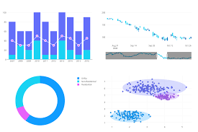



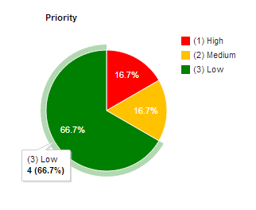

Slide 14
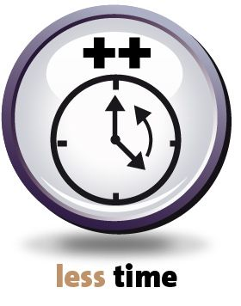


Less Time Consuming
Clear Customer Understanding
More Stable Future Steps
Better Customer Service

Slide 15


Slide 16
METHODOLOGY

Slide 17
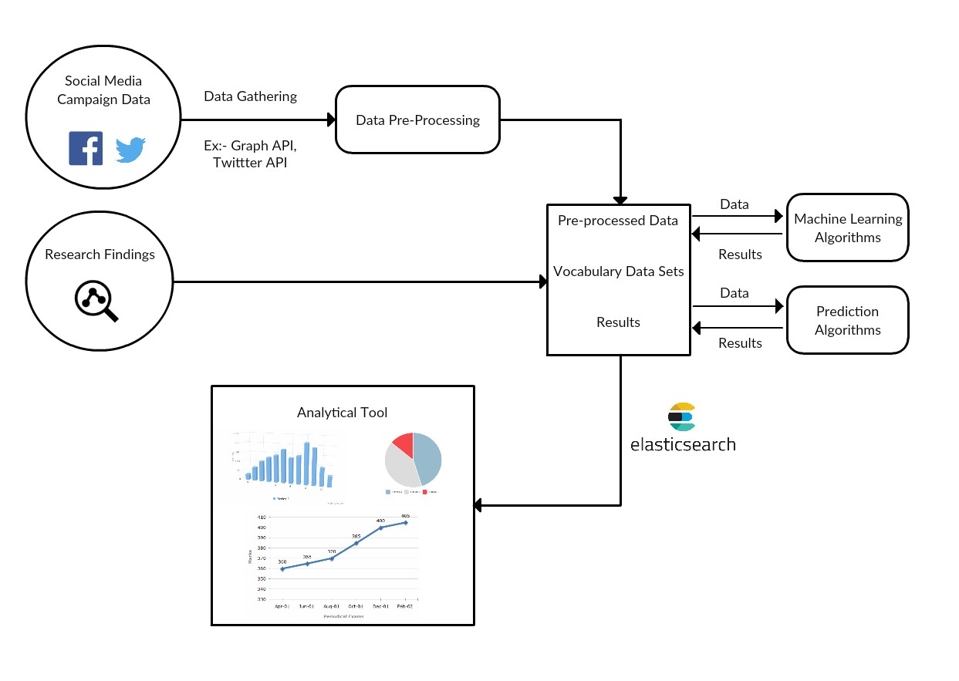
High Level System Architecture

Slide 18
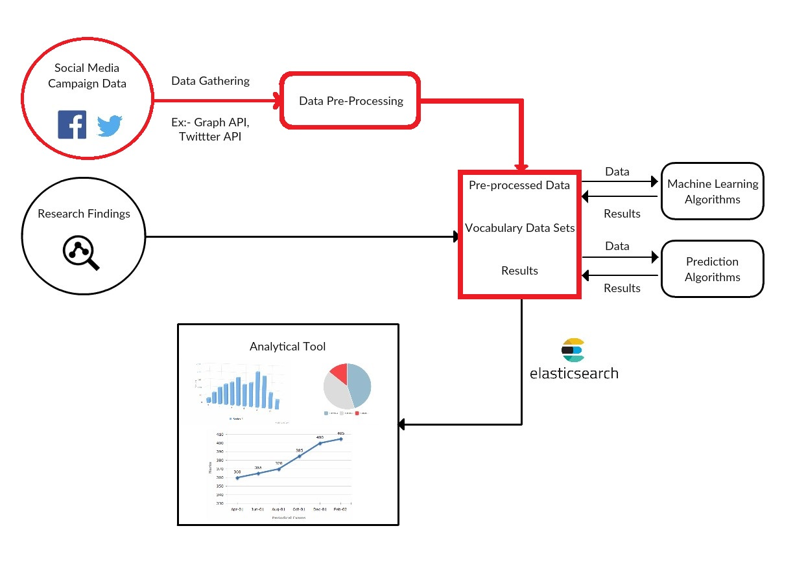
High Level System Architecture

Slide 19
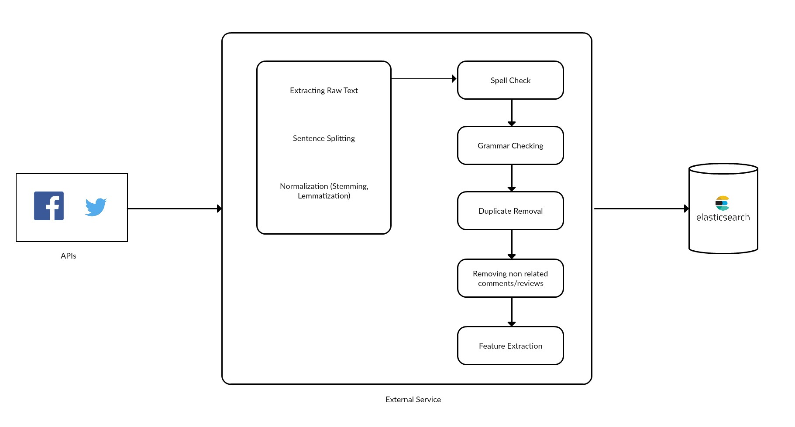

Slide 20
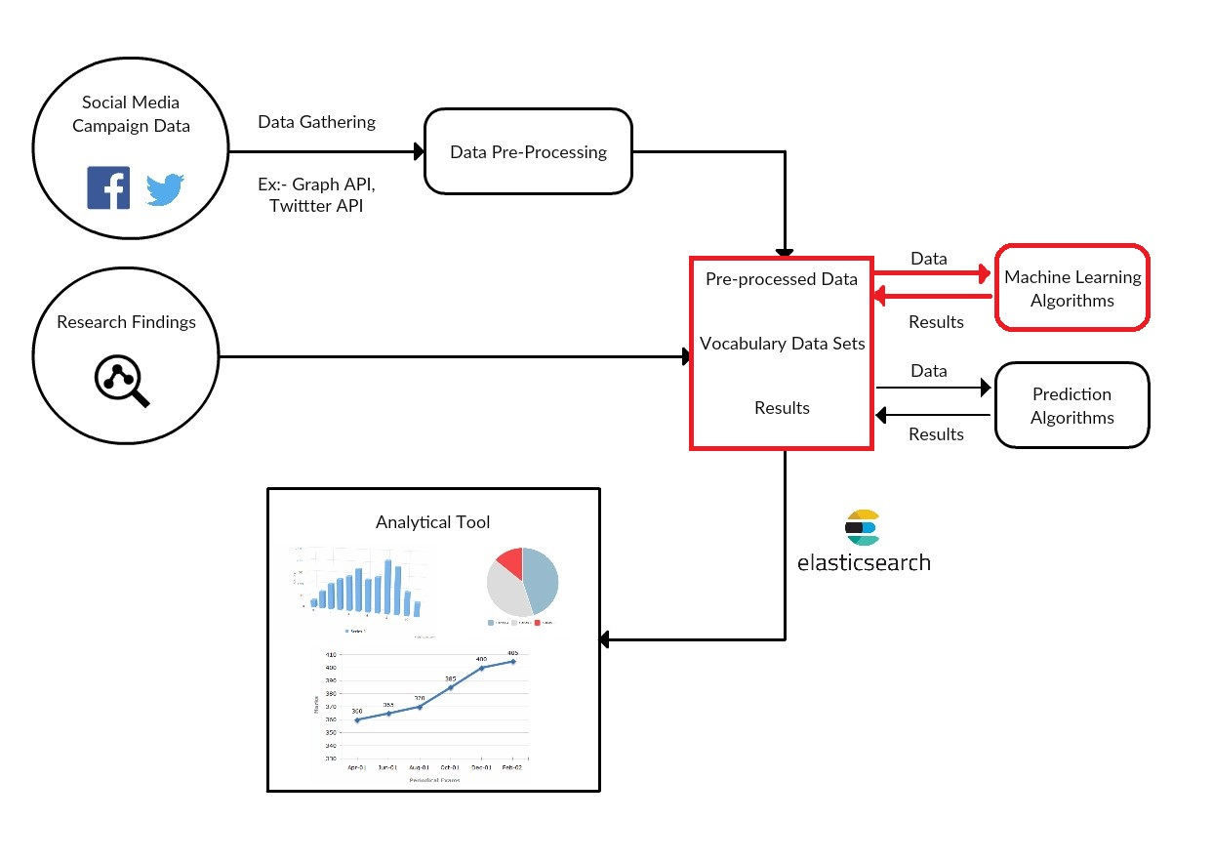
High Level System Architecture

Slide 21
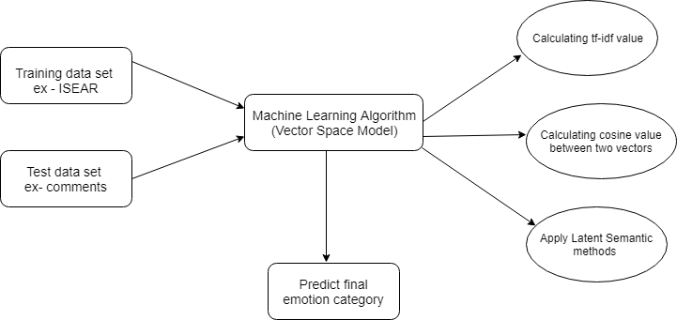

Slide 22
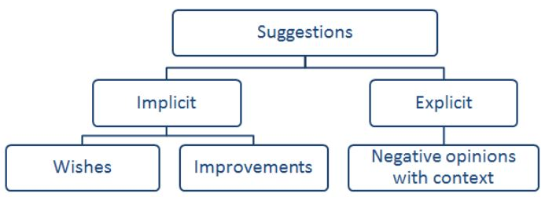
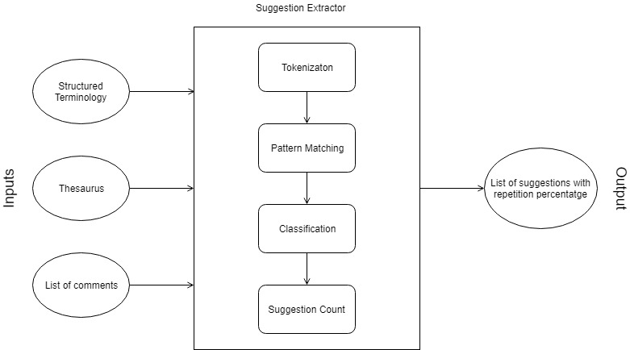

Slide 23
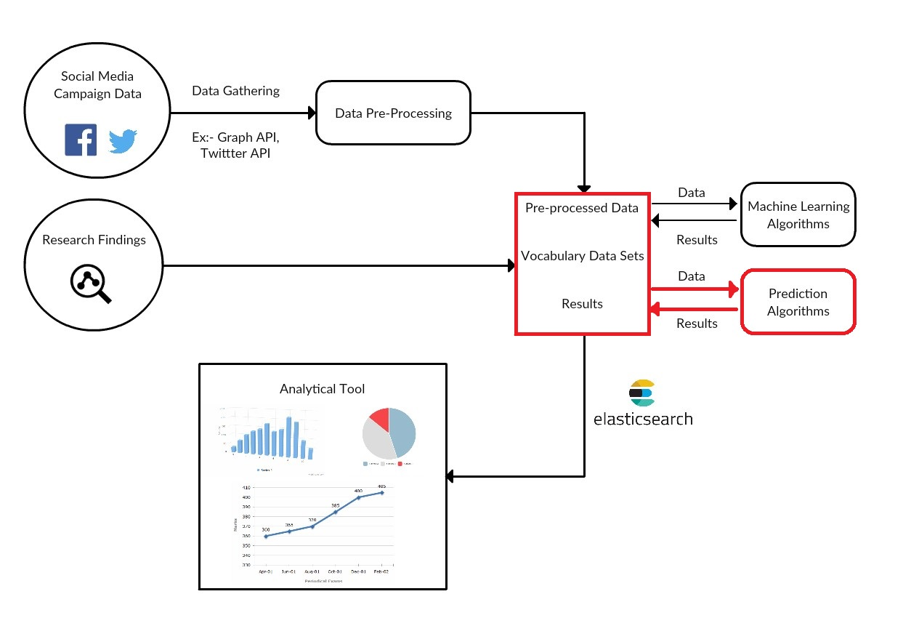
High Level System Architecture

Slide 24
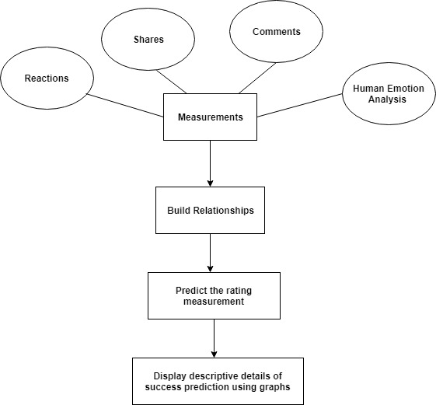

Slide 25
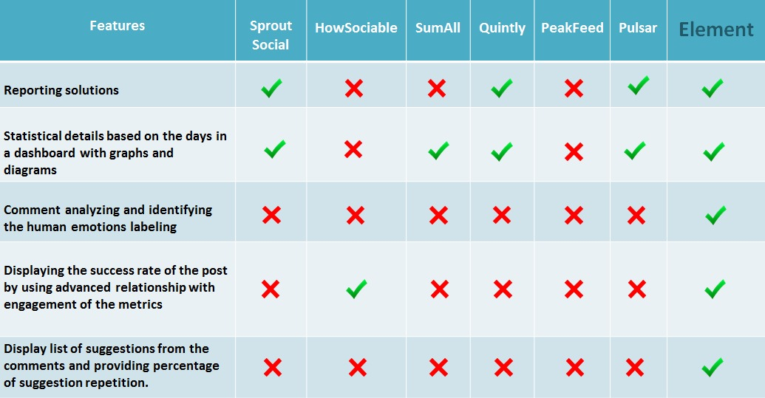
Competitors

Slide 26
Uniqueness
Ability to understand what customer feels about the product precisely.
Able to extract suggestions in a time saving manner.
Able to take more concrete future decisions.
Ability to use for any enterprise using social media marketing.

Slide 27
Overview
Data Preprocessing
Emotional Analysis
Suggestion Extraction
Rating Measurement

Slide 28
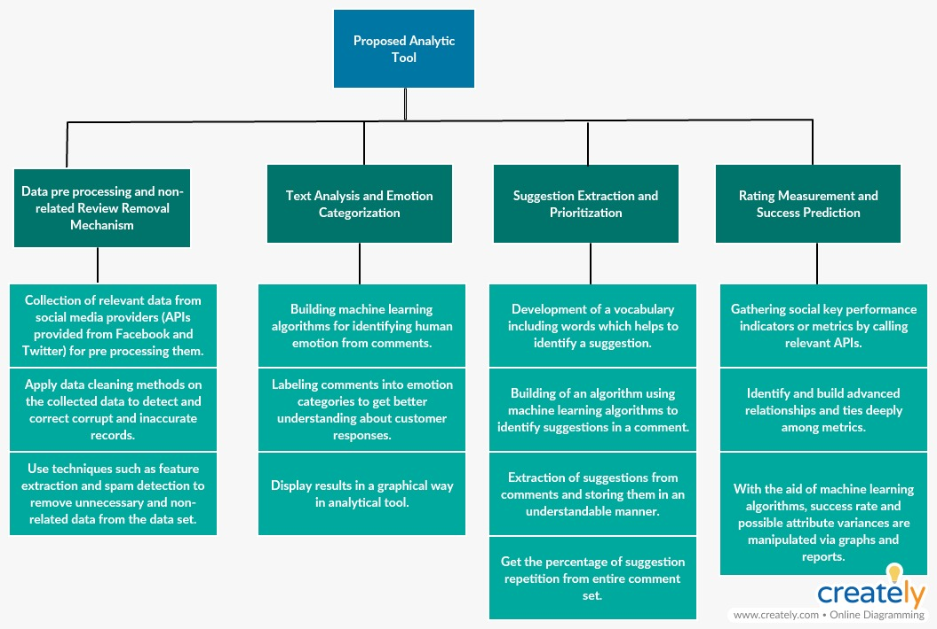
Work Distribution

Slide 29
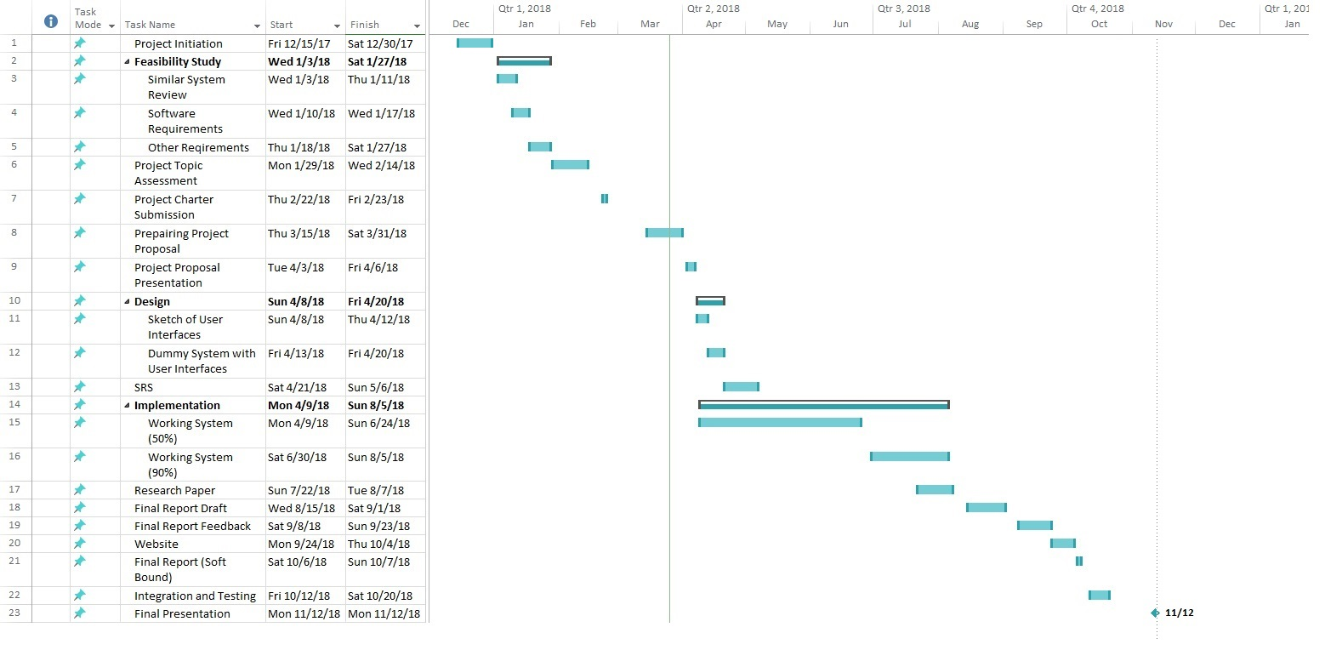
Gantt Chart

Slide 30





Software Technologies
Web Technologies (HTML5, CSS, JavaScript, ReactJS)
Java
Python
ElasticSearch

Slide 31
BUSINESS PLAN

Slide 32


Slide 33
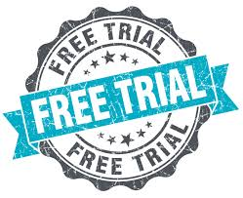



Free Trial – 15 days
Privilege Packages
Social Media Advertising
Advertising Facility for Others
Improvement on Customer Feedback

Slide 34
Feature | Bronze | Silver | Gold
Advertisement Free | No | Yes | Yes
No. of posts to monitor simultaneously | 5 | 10 | Unlimited
No. of accounts to be monitored | 1 | 5 | 10
Maximum no. of days a post to be monitored | 5 | 10 | 15

Slide 35
Target Audience
People who market their products through Social Media.
Enterprise level marketing companies which conducting other business organizations’ advertisement campaigns

Slide 36
Achieving Marketing Performance Successfully
Increased Revenue
Increased Sales
Increased Customer Satisfaction
Increased Customer Understanding

Slide 37
BENEFITS

Slide 38

Enterprise Benefits
Less time consuming
Providing effective services
Increase relationship between their customer and business group

Slide 39

Customer Benefits
Clear understanding about customer requirements
Receiving instant responses
Receiving improved products

Slide 40
with
Your time is saved!

Slide 41
THANK YOU!

Slide 42
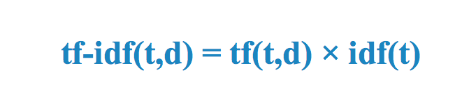
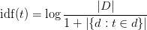
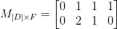
TF-IDF

Slide 43
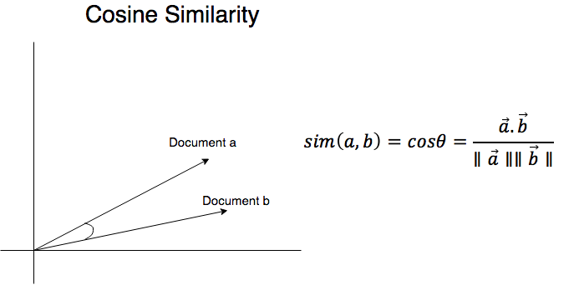
Similarity between two vectors

Slide 44
Social Key Performance Indicators
Also known as “KPIs”
Avinash Kaushik’s 3 major social media metrics
Conversation Rate - No. of Comments
Amplification Rate - No. of Shares in Facebook / No. of Retweets Per Tweet
Applause Rate - No. of Likes in Facebook / No. of favorite clicks per post

Slide 45
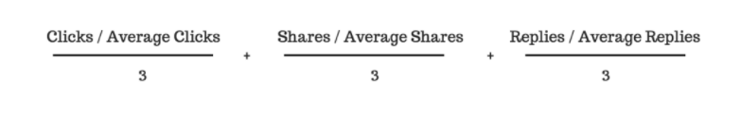
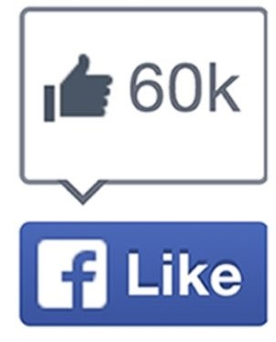
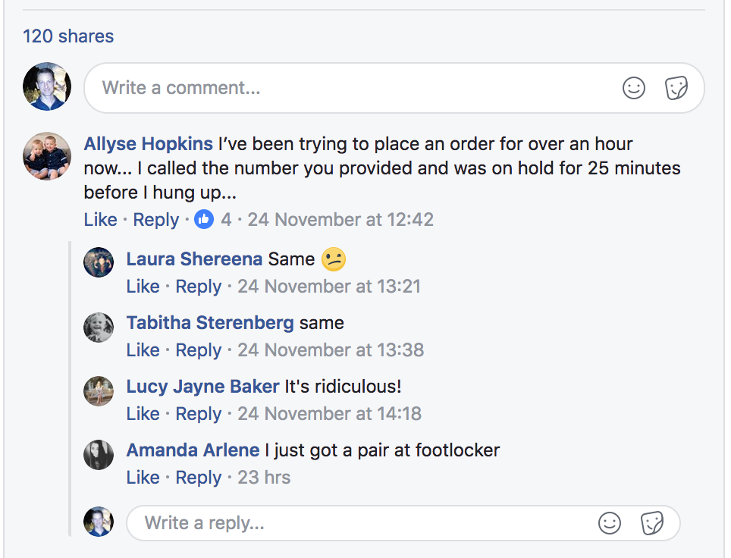
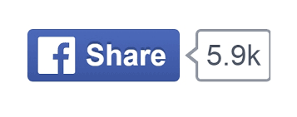
Data is Gathered, So what is next ?
Social media Score

